Slide 1

A Presentation on “TAV-Cart: Transaction Assistance and Validation Cart System for Effortless Shopping and Checkout” By Tanish Singh Rajpal - B202 Akshit Naithani - B208 Vansh Mistry - B223 Under the Guidance of Prof. Kiran Salunke
Department of Computer Engineering
MPSTME, Shirpur Campus
2023-24

Slide 2
Vision And Mission
Vision
To revolutionize the retail shopping experience by eliminating the need for long checkout queues and providing a seamless, efficient, and customer-centric shopping environment.
To lead the retail industry in adopting innovative technologies that enhance operational efficiency and customer satisfaction.
Mission
To develop and implement a smart cart system that integrates advanced technologies like NFC, IoT, and UPI, ensuring a hassle-free shopping experience for customers.
To continuously innovate and enhance the TAV-Cart system, making it adaptable to the changing needs of retail stores and consumers.
To achieve significant cost savings for retailers by optimizing checkout processes and reducing operational overheads.

Slide 3
Index
Sr. No. | Slides | Slide Number
I | Objective of Project | 3
II | Literature Survey | 4
III | Problem Statement | 9
IV | Proposed Solution | 10
V | Software and Hardware Requirements | 11
VI | Project Development Timeline (Gantt Chart) | 15
VII | References | 16

Slide 4
Objective of Project
Goal: To develop a smart cart system that eliminates the need for traditional checkout lines in retail stores.
Key Objectives:
Enhance Shopping Experience: Reduce wait times by automating the checkout process, making shopping faster and more convenient for customers.
Improve Store Efficiency: Streamline operations and reduce the need for manual labor at checkout counters, allowing staff to focus on other important tasks.
Cost Savings: Reduce costs associated with traditional checkout systems and RFID technology by implementing a more cost-effective and scalable smart cart solution.

Slide 5
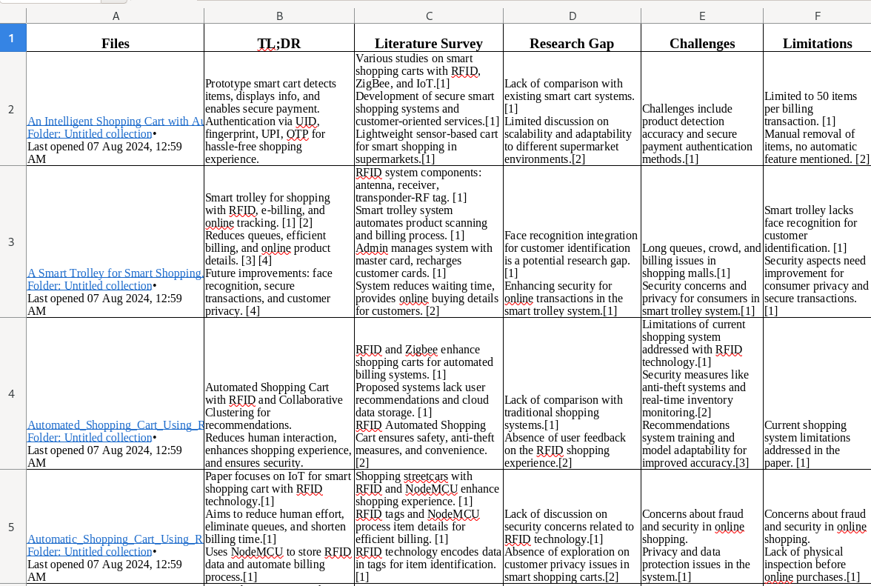
Literature Survey

Slide 6
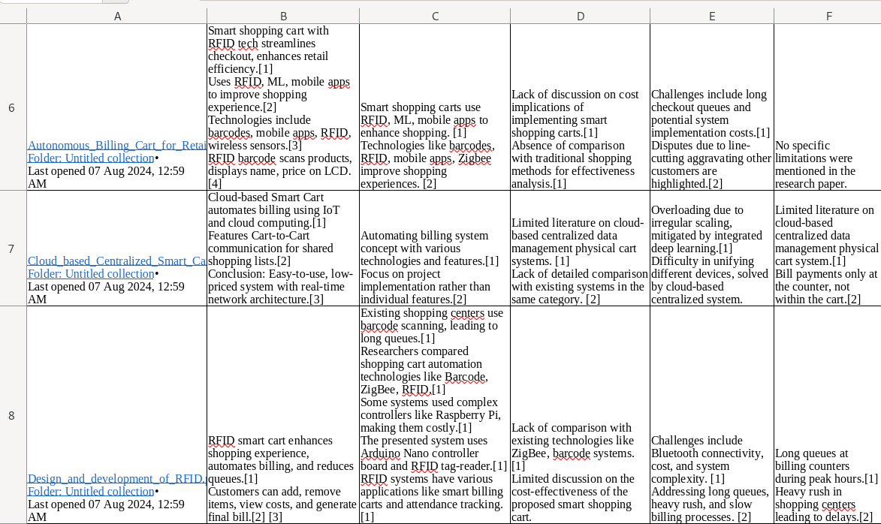
Literature Survey

Slide 7
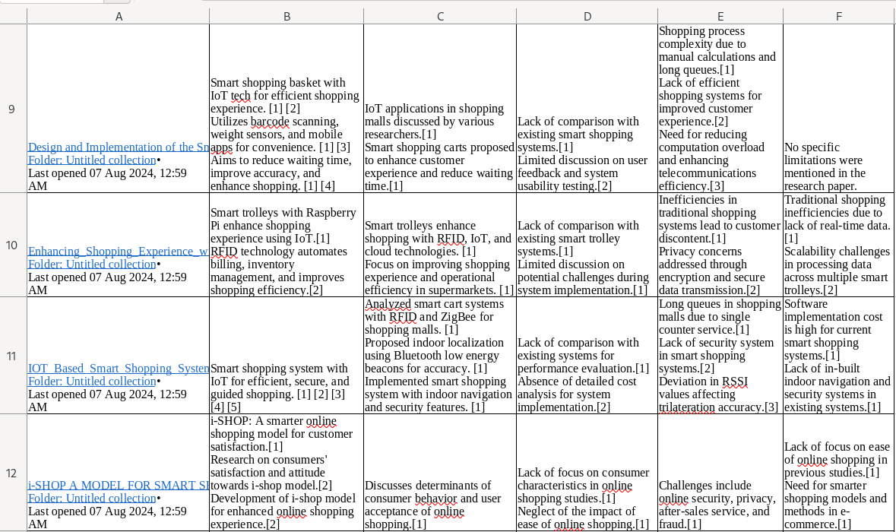
Literature Survey

Slide 8
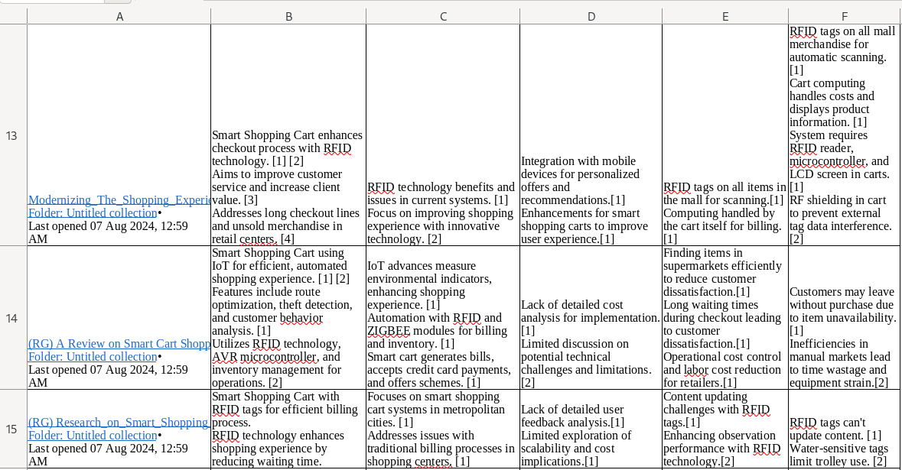
Literature Survey

Slide 9
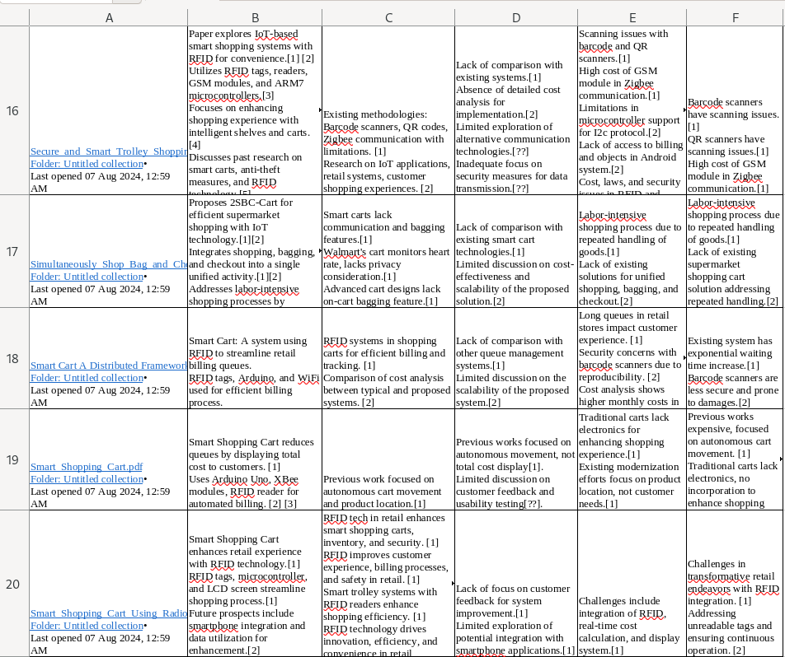
Literature Survey

Slide 10
Problem Statement
The physical shopping marts haven’t been reformed in the last few decades.
With the increase in population and a busy schedule, it is almost impossible to shop at a mart at weekends while expecting no/less crowd.
The traditional method of taking turns at checkout counters to settle the bill is too tedious and time consuming in nature.
Also there is an increasing cost of hiring workers - cashiers on double shifts, helpers, restocking workers, etc. and they are also to be promoted and provided with incentives.
The present solution in RFID carts have obvious privacy concerns and have huge initial setup costs.

Slide 11
Proposed Solution
IoT and UPI Integration:
Utilizes sensors for real-time inventory tracking and product recommendations.
Seamless UPI payments directly from the cart, eliminating checkout queues.
Automated Scanning and Weight Verification:
Automated barcode scanners for accurate item billing.
Weight verification to prevent fraud and ensure billing accuracy.
Real-Time Inventory Management:
Continuous stock updates to reduce out-of-stock situations.
Analyzes customer behavior for optimized stock placement.

Slide 12
Proposed Solution
Enhanced Customer Experience:
Streamlined shopping process with reduced checkout time.
User-friendly interface for easy cart navigation and usage.
Cost-Effective Implementation:
Lower operational costs compared to traditional and RFID systems.
Easily scalable to different store sizes and layouts.
Additional Developments:
Concept ideas for three systems which further modernize the shopping marts.
An automated turnstile system allowing easier security exit checks eradicating the traditional method.
A charging station which can charge multiple carts simultaneously and can be placed at the end of the shopping journeys where customers can dock their carts.
Using NFC tags as form of advertisment where offers and deals on selected products can directly be displayed to users on their carts as they pass by certain sections allowing increase in implusive purchases.

Slide 13
Software and Hardware Requirements
Software Requirements:
IoT Platform:
Description: Manages sensor data and real-time inventory tracking.
Examples: AWS IoT Core, Google Cloud IoT.
Payment Gateway Integration:
Description: Facilitates UPI transactions directly from the cart.
Examples: Razorpay, Paytm Payment Gateway.
Mobile Application:
Description: Interface for customers to interact with the smart cart.
Features: Product recommendations, cart management, payment processing.
Middleware:
Description: Connects IoT devices, databases, and applications.
Examples: Node.js, Python Flask.

Slide 14
Software and Hardware Requirements
Hardware Requirements:
Sensors:
Types: Weight sensors, barcode scanners, NFC Tags (Additional Developments).
Purpose: Track inventory, verify weights, scan barcodes.
Microcontrollers:
Examples: Arduino, Raspberry Pi.
Purpose: Process sensor data and control cart functions.
Connectivity Modules:
Types: Wi-Fi, Zigbee.
Purpose: Enable communication between cart and the cloud server.

Slide 15
Software and Hardware Requirements
Power Supply:
Type: Rechargeable batteries.
Purpose: Provide power to the cart's electronic components.
Display Interface:
Type: LCD or LED screens and programmable light strip.
Purpose: Show product information, billing details, and cart status.

Slide 16
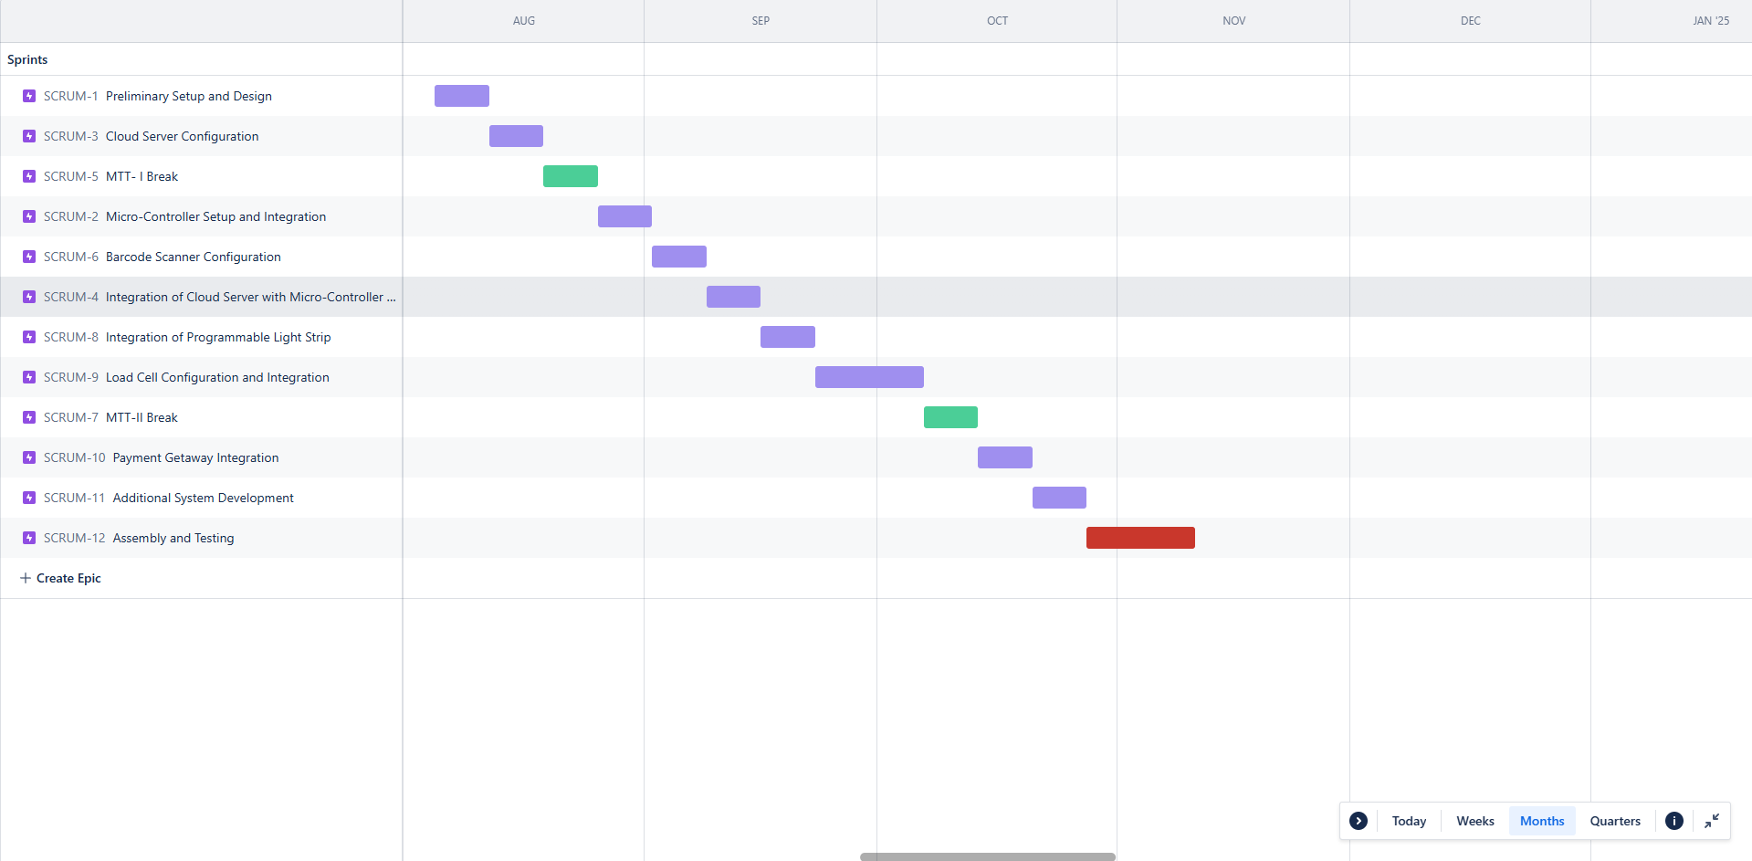
Project Development Timeline (Gantt Chart)
5 August 2024 - 10 November 2024

Slide 17
References
[1] S.Karjol & A. Holla & C.B. Abhilash. (2018). An IOT Based Smart Shopping Cart for Smart Shopping. 10.1007/978-981-10-9059-2_33.
[2] C, Roopa & Reddy, Nivas. (2020). Research on Smart Shopping Cart. International Journal of Scientific Research in Computer Science, Engineering and Information Technology. 359-363. 10.32628/CSEIT206468.
[3] T. K. Das, A. K. Tripathy and K. Srinivasan, "A Smart Trolley for Smart Shopping," 2020 International Conference on System, Computation, Automation and Networking (ICSCAN), Pondicherry, India, 2020, pp. 1-5, doi: 10.1109/ICSCAN49426.2020.9262350. keywords: {Databases;RFID tags;Wireless fidelity;Postal services;Smart cards;Libraries;Bar codes;Shopping Trolley;RFID Reader;RFID Tag;IOT;Smart Cart;e-Billing},
[4] S. R. Subudhi and R. N. Ponnalagu, "An Intelligent Shopping Cart with Automatic Product Detection and Secure Payment System," 2019 IEEE 16th India Council International Conference (INDICON), Rajkot, India, 2019, pp. 1-4, doi: 10.1109/INDICON47234.2019.9030331. keywords: {Radiofrequency identification;Authentication;Fingerprint recognition;Internet of Things;Liquid crystal displays;Monitoring;Biomedical monitoring;Intelligent Shopping Cart;Secure payment;Fingerprint sensor;RFID;UPI;UID;Automation},
[5] R. Gupte, S. Rege, S. Hawa, Y. S. Rao and R. Sawant, "Automated Shopping Cart Using RFID with a Collaborative Clustering Driven Recommendation System," 2020 Second International Conference on Inventive Research in Computing Applications (ICIRCA), Coimbatore, India, 2020, pp. 400-404, doi: 10.1109/ICIRCA48905.2020.9183100. keywords: {Databases;Security;Real-time systems;RFID tags;Collaboration;Industries;Smart Shopping Cart;RFID;Collaborative Clustering;Artificial Intelligence;Automation;COVID-19},
[6] J. Guntur, S. S. Raju, M. Srikanth and N. S. S. Kumar, "Automatic Shopping Cart Using RFID and NodeMCU," 2023 International Conference on Computer Communication and Informatics (ICCCI), Coimbatore, India, 2023, pp. 1-5, doi: 10.1109/ICCCI56745.2023.10128538. keywords: {Technological innovation;Animals;Planets;Urban areas;Organizations;Liquid crystal displays;Internet of Things;RFID;ESP8266NodeMCU;Internet of Things (IoT);Smart Shopping cart;WiFi},
[7] T. T, P. G, K. R, D. G. I, V. J and K. K. S, "Autonomous Billing Cart for Retail Store," 2023 Intelligent Computing and Control for Engineering and Business Systems (ICCEBS), Chennai, India, 2023, pp. 1-5, doi: 10.1109/ICCEBS58601.2023.10448643. keywords: {Machine learning algorithms;Transforms;Speech recognition;Liquid crystal displays;Mobile applications;Security;Radiofrequency identification;Autonomous shopping cart;RFID;Barcode Scanner;NLP;LCD;Raspberry Pi},

Slide 18
References
[8] H. N. Mahendra, S. Mallikarjunaswamy, C. B. Nooli, M. Hrishikesh, N. Kruthik and H. M. Vakkalanka, "Cloud based Centralized Smart Cart and Contactless Billing System," 2022 7th International Conference on Communication and Electronics Systems (ICCES), Coimbatore, India, 2022, pp. 820-826, doi: 10.1109/ICCES54183.2022.9835856. keywords: {Wide area networks;Wireless communication;Training;Cloud computing;Databases;Computational modeling;Real-time systems;Internet of Things (IoT);Cloud computing;ESP8266 Wi-Fi Module;Software-defined Wide Area Network (SD-WAN);Radio Frequency Identification (RFID);Quick Response Code (QR Code);Smart Cart},
[9] S. Mekruksavanich, "Design and Implementation of the Smart Shopping Basket Based on IoT Technology," 2019 14th International Joint Symposium on Artificial Intelligence and Natural Language Processing (iSAI-NLP), Chiang Mai, Thailand, 2019, pp. 1-6, doi: 10.1109/iSAI-NLP48611.2019.9045336. keywords: {smart shopping cart;Internet of Things (IoT);weight sensor;load cell},
[10] Anushka, V. Mishra, S. Bhardwaj and R. Vashisth, "Design and Development of Smart Cart System using Artificial Intelligence," 2021 6th International Conference on Signal Processing, Computing and Control (ISPCC), Solan, India, 2021, pp. 127-130, doi: 10.1109/ISPCC53510.2021.9609507. keywords: {Microcontrollers;Touch sensitive screens;Signal processing;Logic gates;DC motors;Light emitting diodes;Liquid crystal displays;Automated Billing System;Automated Moving System;RFID;IR;Arduino UNO},
[11] K. Naikade and R. Raman, "Enhancing Shopping Experience with Raspberry Pi and Cloud-Integrated Wireless Sensor Networks for Smart Trolleys in IoT," 2023 International Conference on Self Sustainable Artificial Intelligence Systems (ICSSAS), Erode, India, 2023, pp. 1086-1090, doi: 10.1109/ICSSAS57918.2023.10331668. keywords: {Wireless communication;Temperature sensors;Wireless sensor networks;Cloud computing;Target tracking;Scalability;Real-time systems;Smart Shopping;Smart trolley;Cloud server;Data Management;Customer Satisfaction},
[12] A. Kumar and A. B. M. Shawkat, "i-SHOP: A Model for Smart Shopping," 2016 3rd Asia-Pacific World Congress on Computer Science and Engineering (APWC on CSE), Nadi, Fiji, 2016, pp. 139-143, doi: 10.1109/APWC-on-CSE.2016.032. keywords: {Security;Electronic commerce;Business;Internet;Consumer behavior;Usability;Web sites;Electronic commerce;i-shop;Smart Shopping},
[13] V. Perera, L. Ekanayake, A. Bandara, D. Shakya and U. S. Oruthota, "IOT Based Smart Shopping System," 2021 10th International Conference on Information and Automation for Sustainability (ICIAfS), Negambo, Sri Lanka, 2021, pp. 225-229, doi: 10.1109/ICIAfS52090.2021.9606124. keywords: {Smart cards;Schedules;Urban areas;Sociology;Radio navigation;Reliability;Sustainable development;Internet of things;Radio frequency identification;Smart shopping cart},

Slide 19
References
[14] A. M. Shakir, Y. Mudhafar and A. M. A. Al-muqarm, "Modernizing The Shopping Experience: The Smart Shopping Cart," 2023 6th International Conference on Engineering Technology and its Applications (IICETA), Al-Najaf, Iraq, 2023, pp. 636-640, doi: 10.1109/IICETA57613.2023.10351269. keywords: {Radio frequency;Costs;Databases;Radio transmitters;Urban areas;Receivers;Software;RFID tag;LCD;RFID reader;Barcode reader;Trolley;RF models;Central billing unit},
[15] A. Jain, A. Bhola, S. Upadhyay, A. Singh, D. Kumar and A. Jain, "Secure and Smart Trolley Shopping System based on IoT Module," 2022 5th International Conference on Contemporary Computing and Informatics (IC3I), Uttar Pradesh, India, 2022, pp. 2243-2247, doi: 10.1109/IC3I56241.2022.10073159. keywords: {Databases;Prototypes;Manuals;Inventory management;Internet of Things;Informatics;Monitoring;IoT;Smart Shopping;Smart Cart},
[16] T. Arciuolo and A. -s. Abuzneid, "Simultaneously Shop, Bag, and Checkout (2SBC-Cart): A Smart Cart for Expedited Supermarket Shopping," 2019 International Conference on Computational Science and Computational Intelligence (CSCI), Las Vegas, NV, USA, 2019, pp. 1162-1167, doi: 10.1109/CSCI49370.2019.00219. keywords: {Wireless fidelity;Global Positioning System;Bagging;Databases;Real-time systems;RFID tags;Supermarket, Shopping Cart, RFID, Barcode Reader, Load Cells, Raspberry Pi, WiFi, IoT, Database, GPS, WSN},
[17] B. Kumar Yadav, A. Burman, A. Mahato, M. Choudhary and A. Kundu, "Smart Cart: A Distributed Framework," 2020 IEEE 1st International Conference for Convergence in Engineering (ICCE), Kolkata, India, 2020, pp. 210-213, doi: 10.1109/ICCE50343.2020.9290605. keywords: {RFID tags;Conferences;Wireless fidelity;Servers;Convergence;Zigbee;Smart cards;Distributed Cart;Distributed System;RFID based Billing;Smart Cart;Smart Trolley},
[18] G. R. Kesava, V. K. Reddy, S. Trivikram and S. S. K, "Smart Shopping Cart Using Radio Frequency Identification," 2024 IEEE International Students' Conference on Electrical, Electronics and Computer Science (SCEECS), Bhopal, India, 2024, pp. 1-5, doi: 10.1109/SCEECS61402.2024.10482043. keywords: {Computer science;Costs;Microcontrollers;Customer satisfaction;Manuals;Liquid crystal displays;Real-time systems;Smart Shopping Cart;Radio Frequency Identification (RFID);Real-time Cost Updates;Efficiency and Convenience;RFID Technology Integration;Seamless Shopping Experience},
[19] A. Kumar, A. Gupta, S. Balamurugan, S. Balaji and R. Marimuthu, "Smart Shopping Cart," 2017 International conference on Microelectronic Devices, Circuits and Systems (ICMDCS), Vellore, India, 2017, pp. 1-4, doi: 10.1109/ICMDCS.2017.8211723. keywords: {Liquid crystal displays;Radiofrequency identification;Microcontrollers;Databases;Pins;Registers;Hardware;Arduino;RFID;Shopping cart;Wireless Communication;Xbee},

